Slide 1
Electroproduction of π⁺π⁻p in the 2nd resonance region off protons
G. Fedotov, R. W. Gothe

Slide 2
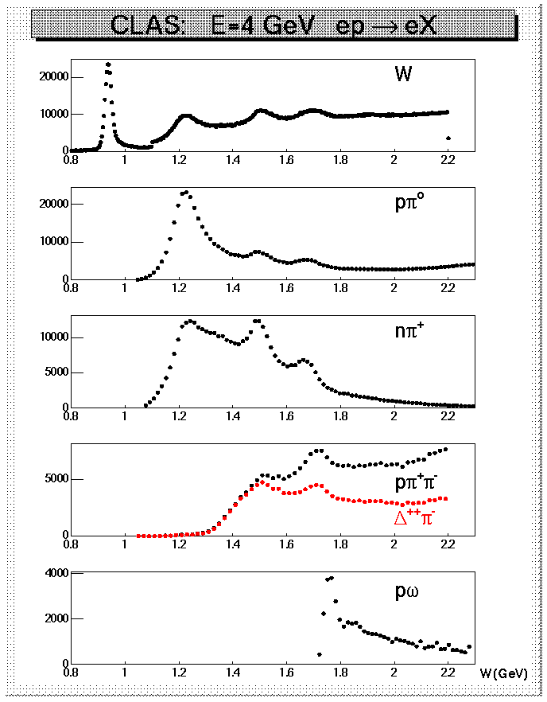
Why is π⁺π⁻p electroproduction important?
Resonant amplitudes
π, η, ππ,..
Non-resonant amplitudes
π, η, ππ,..
γ_{v}
*
N*,△
+
N
N’
A_{3/2}, A_{1/2}, S_{1/2}
G_{M}, G_{E}, G_{C}
N’
N
Q² averaged from 0.2 GeV² to 4 GeV²
  consistent results obtained from the analyses of Nπ and π⁺π⁻p channels give confidence that N* electrocouplings can be extracted reliably from these channels
  π⁺π⁻p channel is sensityive to high mass N*, most of them preferably decay to Nππ final states

Slide 3
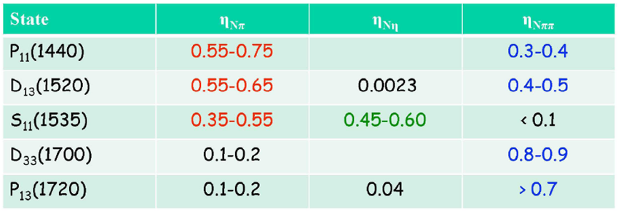
2nd and 3rd nucleon resonance regions (PDG 2006)
Notes:
Delta регион только по 1-о пионному каналу распадается.
Второй D13 и S11 пик и широкий Ропер
3-я область много резонансов но при больших W приимкщественно распадаютя на 2pi
S11 открытый вопрос

Slide 4
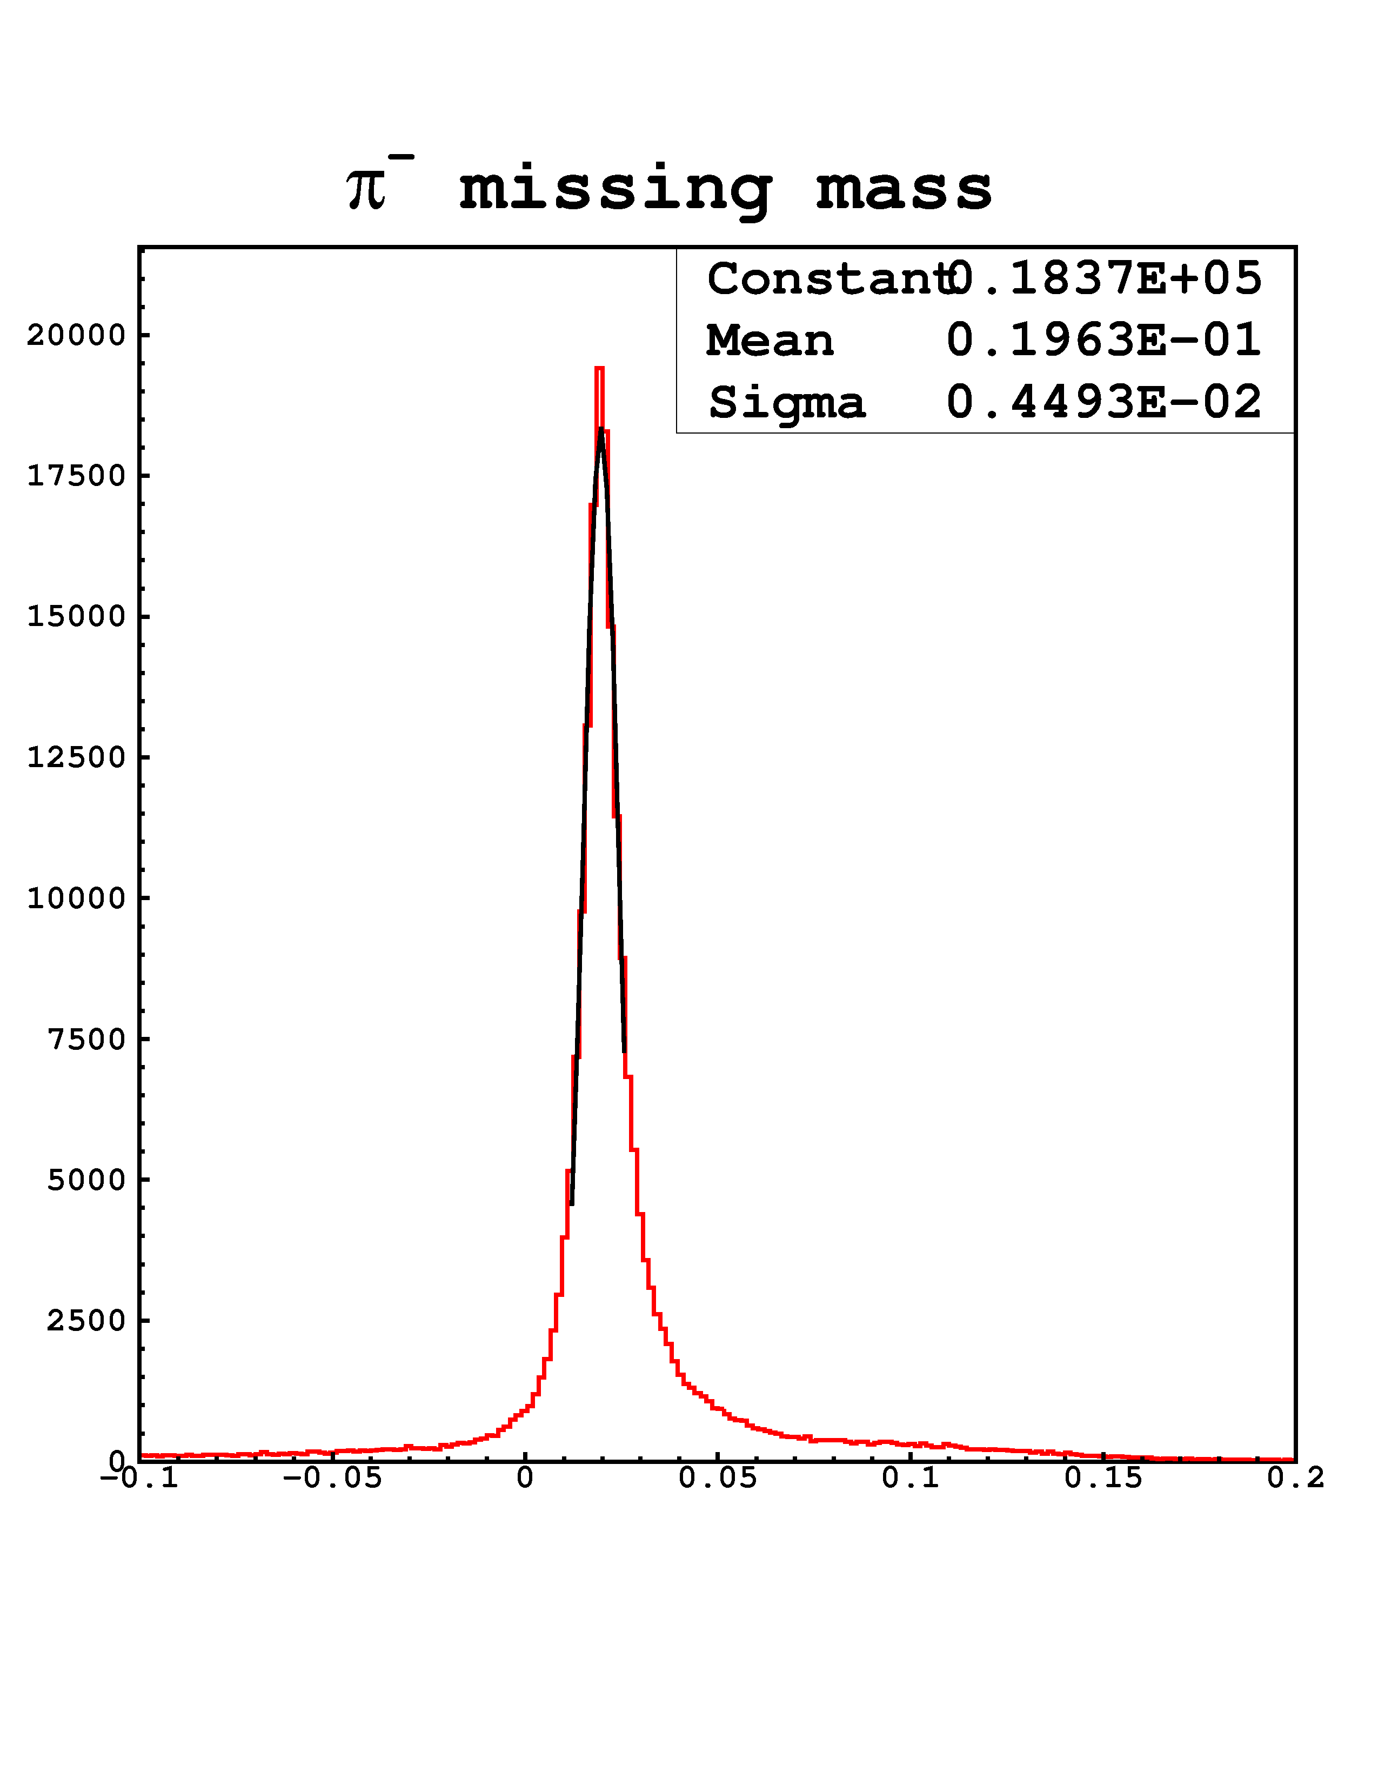
Kinematically available area
π⁻ missing mass squared

Slide 5
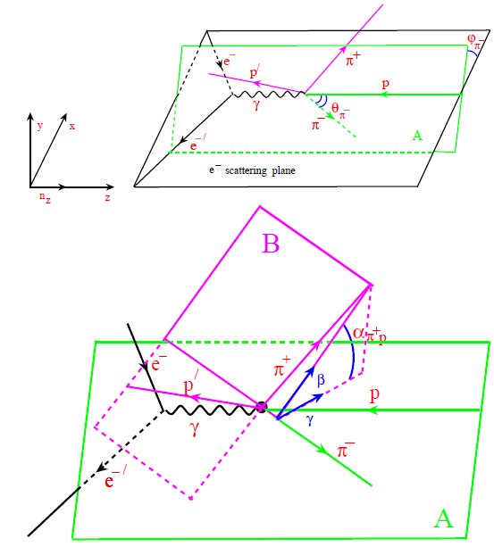
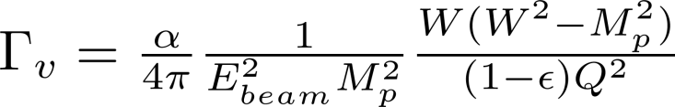
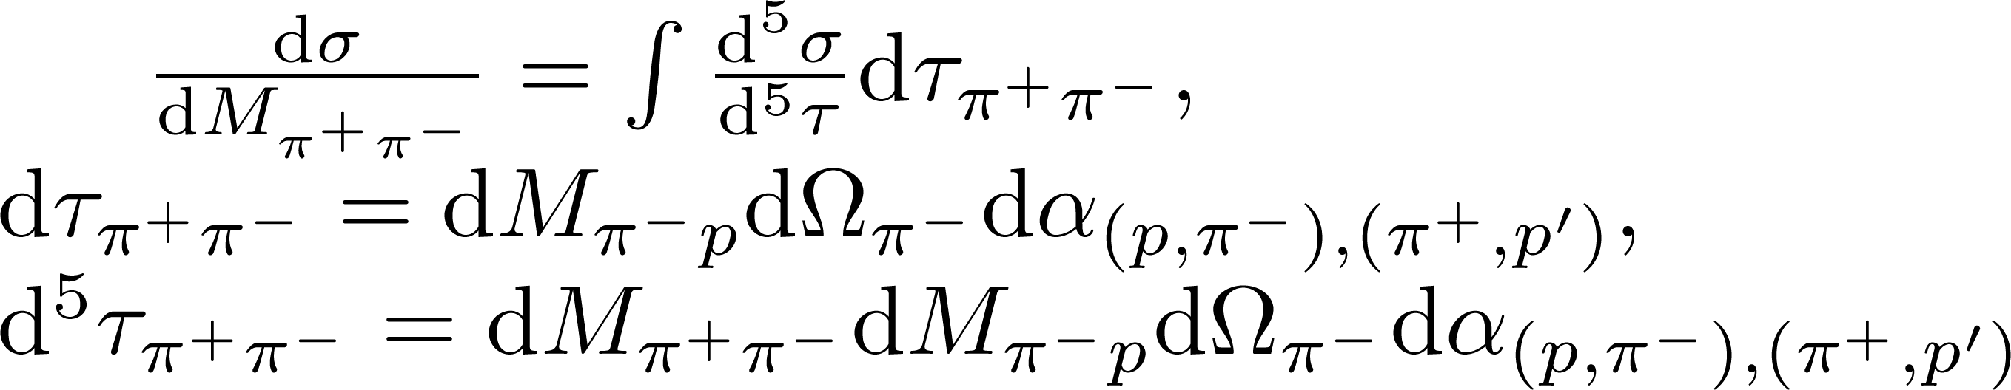
Kinematical variables

Slide 6
CLAS data on π⁺π⁻p differential cross sections and their description within the JM model
G.V.Fedotov et al., PRC 79 (2009), 015204
full JM calc.
full JM calc.
π⁺Δ⁰
π⁺Δ⁰
π⁻Δ⁺⁺
π⁻Δ⁺⁺
2π direct
2π direct

Slide 7
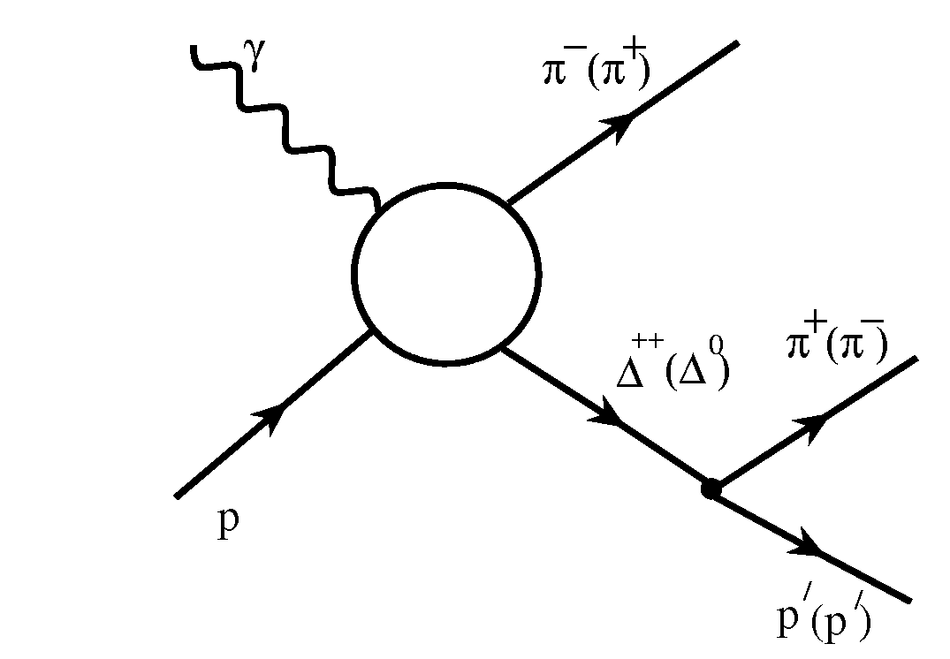
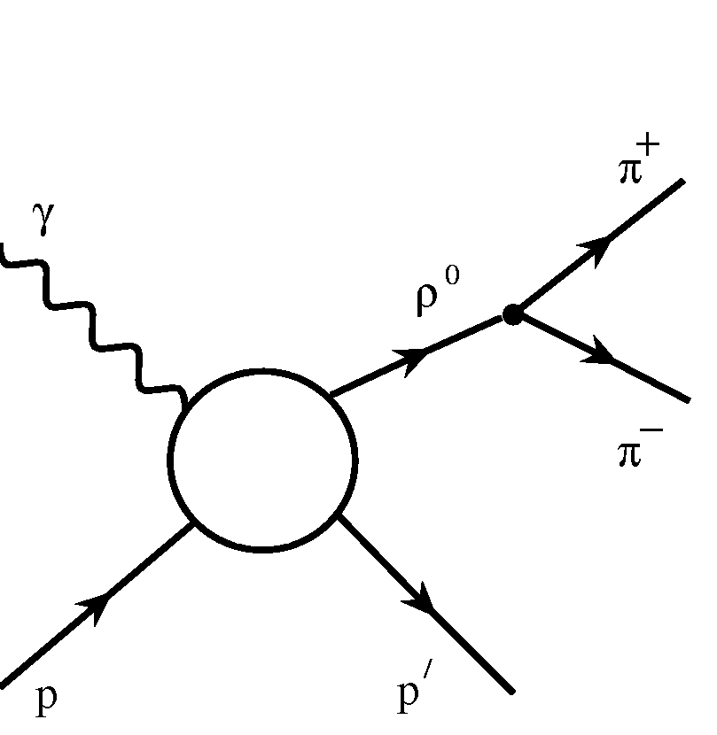
JLAB-MSU meson-baryon model (JM) for Nππ electroproduction
Included isobar channels:
π⁻Δ⁺⁺
3-body processes:
  All well established N*s with πΔ decays and 3/2⁺(1720) candidate.
  Reggeized Born terms with effective FSI & ISI treatment .
  Extra πΔ contact term.
ρ⁰p
  All well established N*s with rp decays and 3/2+(1720) candidate.
  Diffractive ansatz for non-resonant part and r-line shrinkage in N* region.

Slide 8
JLAB-MSU meson-baryon model (JM) for Nππ electroproduction
Direct 2π production required by unitarity and established for the first time in analysis of the CLAS π⁺π⁻p data
Most relevant
at W<1.65 GeV
Negligible at
W>1.70 GeV
Implementation of direct mechanisms allows us to move beyond the isobar
approximation describing π⁺π⁻p exclusive channel.
JM model :V. Mokeev , V.D.Burkert,T.-S.H.Lee et al., Phys. Rev. C80, 045212 (2009).
Recent updates will be presented in the CLAS paper, that is in preparation.

Slide 9
Resonant & non-resonant parts of Nππ cross sections as determined from the CLAS data fit within the framework of JM model
Reliable and unambiguous separation between resonant and non-resonant contribution was achieved
full cross sections
resonant part
non-resonant part

Slide 10
P₁₁(1440) electrocouplings from the CLAS data on Nπ/Nππ electroproduction
Nππ preliminary
Nπ
S_{1/2}
I.Aznauryan,V.Burkert, et al., PRC 80,055203 (2009).
A_{1/2}
  Good agreement between the electrocouplings obtained from the Nπ and Nππ channels: Reliable measurement of the electrocouplings.

Slide 11
P₁₁(1440) electrocouplings from the CLAS data on Nπ/Nππ electroproduction
Quark models:
I. Aznauryan LC
S. Capstick LC
G. Ramalho QM based on relat. cov. approach by F.Gross
MB dressing abs. val. (EBAC)
  The electrocouplings are consistent with P₁₁(1440) structure as a superposition of the contributions from: a) quark core as the first radial excitation of the nucleon as a 3-quark ground state and b) meson-baryon dressing.

Slide 12
D₁₃(1520) electrocouplings from the CLAS data on Nπ/Nππ electroproduction
A_{3/2}
A_{1/2}
S_{1/2}
Nππ preliminary
Nπ
MB dressing abs val. (EBAC)
I.Aznauryan,V.Burkert, et al., PRC 80,055203(2009).
M.Giannini/E.Santopinto
hCQM
good agreement between the results from Nπ & Nππ channels
substantial contributions from quark core at Q²>2.0 GeV² and sizable MB cloud
at Q²<1.0 GeV²
The results on A_{1/2} electrocouplings at Q²>2.0 GeV² for the first time offer almost direct access to the quark core!

Slide 13
Motivation for my current analysis
First results from Nππ electroproduction channel on γ_{v}NN* electrocouplings for most resonances with masses M<1.8 GeV at photon virtualities from 0.4 to 1.1 GeV².
Enhance considerably our capabilities:
to determine electrocouplings of high lying N*s in the mass range M>1.6 GeV
to search for 3/2⁺(1720) candidate state by exploring the Q² evolution of γ_{v}p→π⁺π⁻p cross sections around W~1.7 GeV
Notes:
This measurement were motivated by two major objectives. First we are going to extract pion delta axial transition form factor. It will
be first data on this axial transition form factor from experiments with electromagnetic probes. Second we will complement available
data on photocoupling for Roper and D13(1520) resonances at low Q2. Moreover hadronic pi delta and rho proton coupling are poorly known and we are going to extract accurate information on this hadronic coupling.

Slide 14
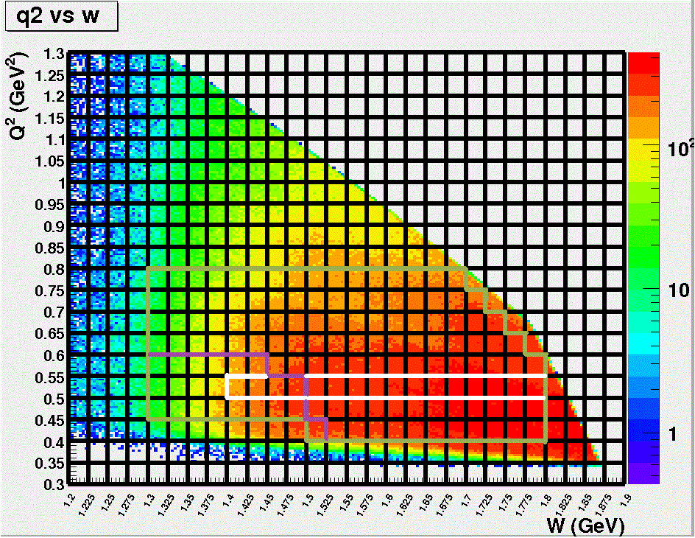
Available kinematical area
Plot shows Nππ events collected in bins over W and Q². 7d ep→eπ⁺π⁻p cross section were computed after further binning of each 2d cell over 5 variables, that describe the kinematic of the final hadron state.

Slide 15
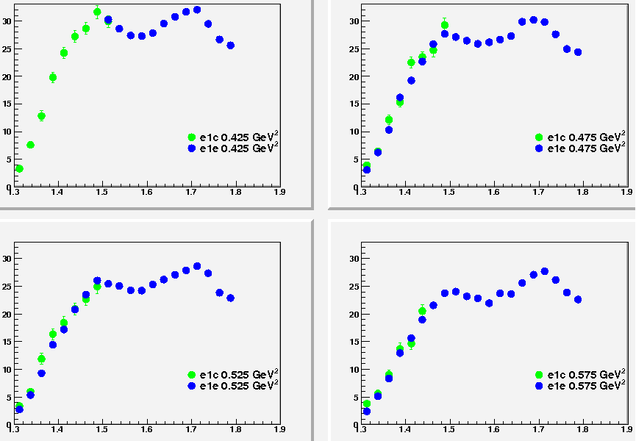
Fully integrated Nππ cross sections in comparison with existing data
Green dotes represent published data (Fedotov et al., CLAS Collaboration, PRC79, 015204 (2009)) , while blue dotes are new e1e data. Good agreement in overlapped areas.

Slide 16
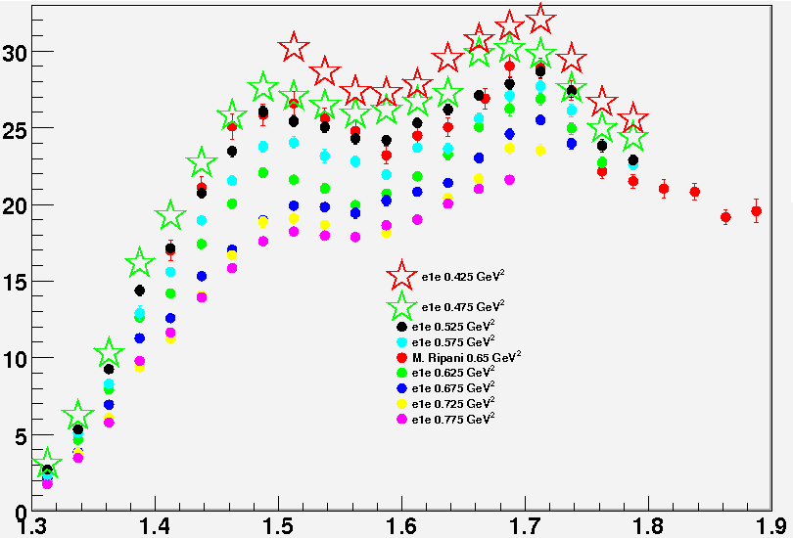
Comparison with existing data (continued)
W (GeV)
Solid red circles represent M. Ripani data, while all other symbols represent new e1e data at various Q². Good agreement between e1e data at Q²=0.525 GeV² and M. Ripani data at Q²=0.65 GeV² (PRL91 022002 (2003)). Note: M. Ripani data were averaged over wide Q² bin from 0.5 to 0.8 GeV² .

Slide 17
Conclusions
Preliminary data on γ_{v}p→π⁺π⁻p cross sections were obtained for W from 1.4 GeV to 1.8 GeV and Q² from 0.4 GeV² to 1.1 GeV²
Kinematic coverage and statistics exceed the previously available CLAS data and allow for a six times finer binning in Q²
The phenomenological analysis of this data will extend considerably the available information on the Q² evolution of the high lying N* electrocouplings

